Slide 1
Green House
Cal Colistra

Slide 2
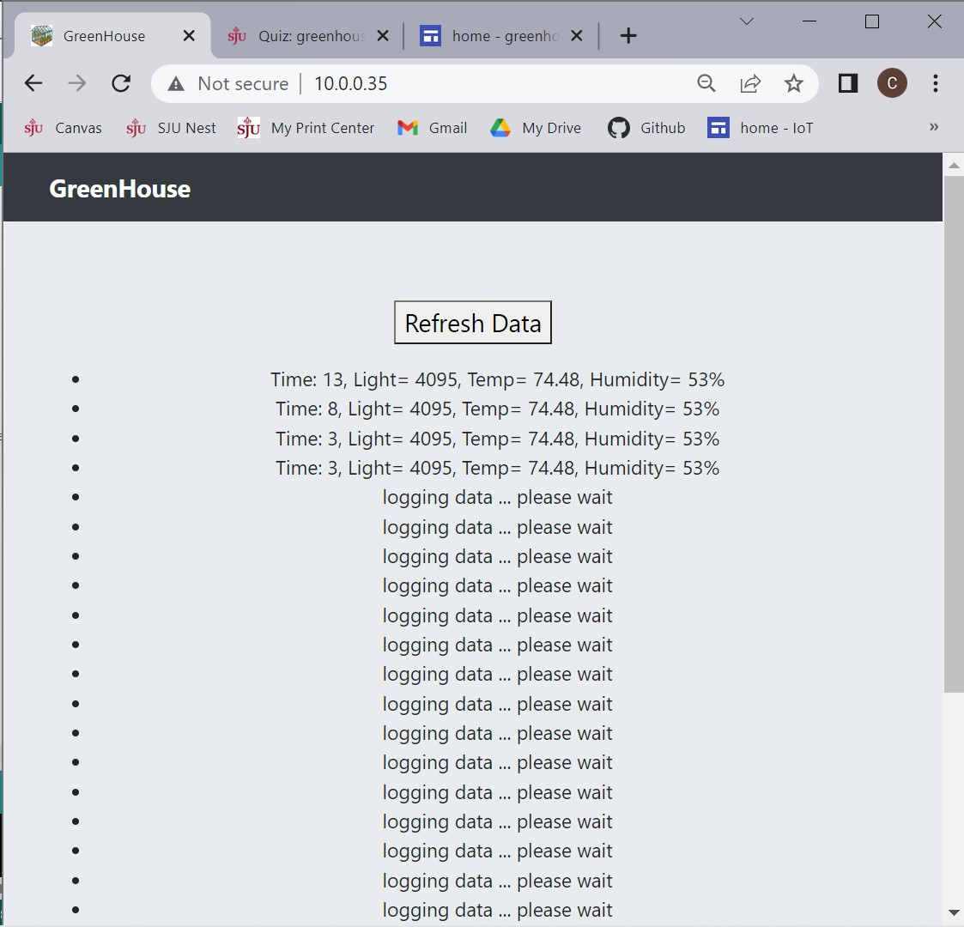

Slide 3
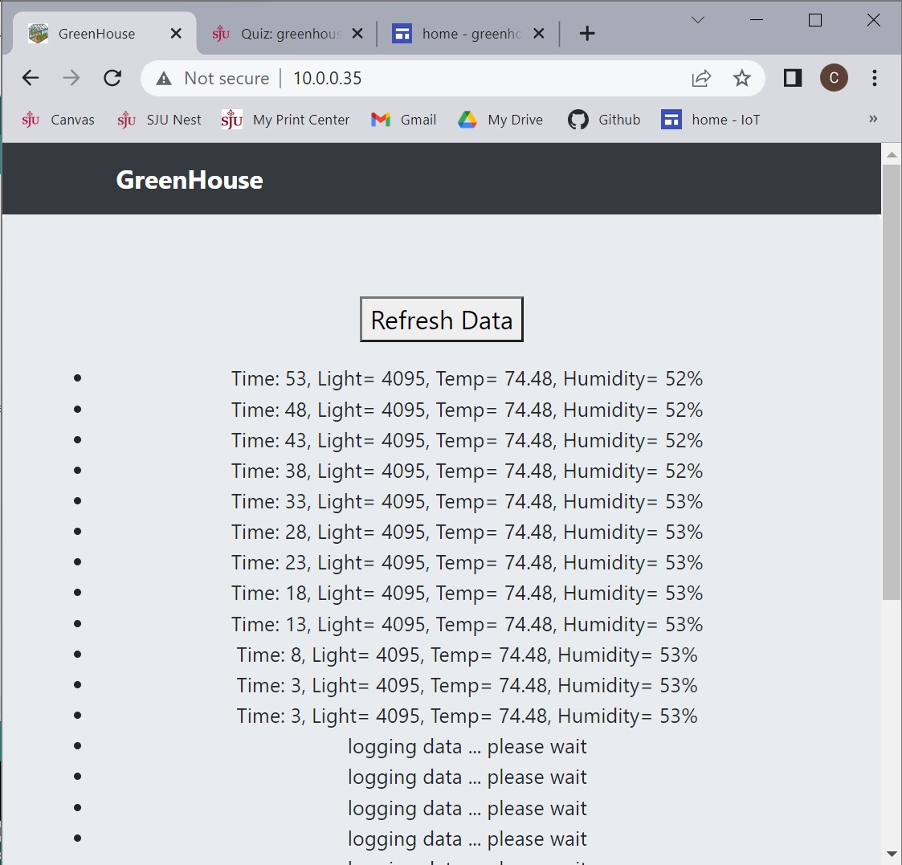
This screenshot is after waiting then refreshing the data

Slide 4
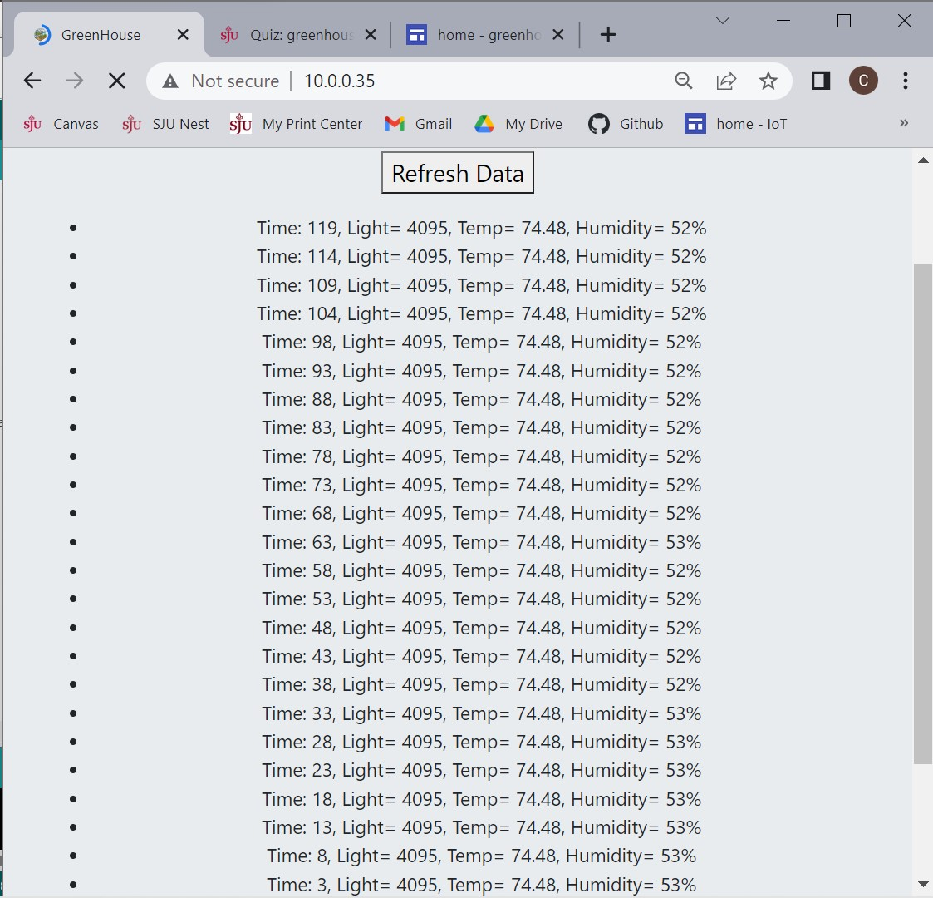
This screenshot shows K (25) data logs after waiting then refreshing

Slide 5
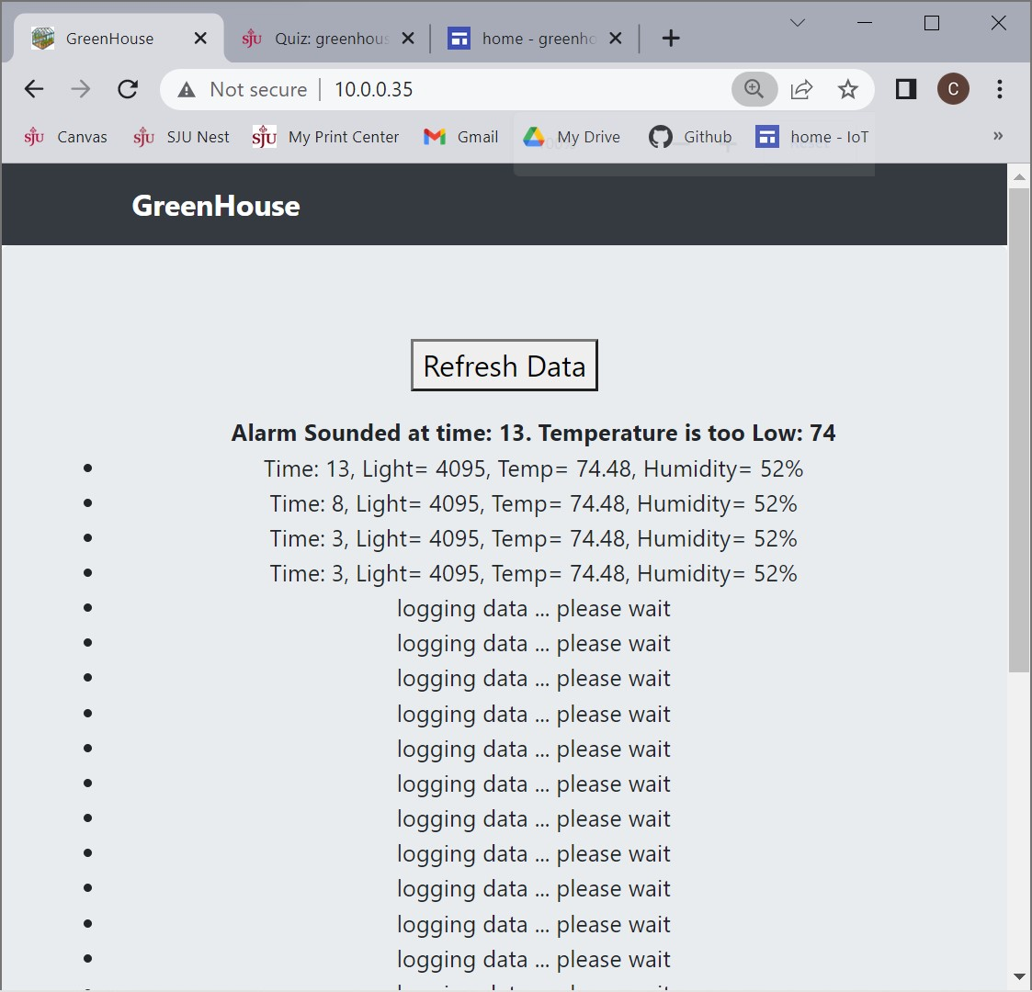
This screenshot shows what happens when the temp goes below TLOW variable.
Note: I changed TLOW to 90 to just to show the functionality of the alarm

Slide 6
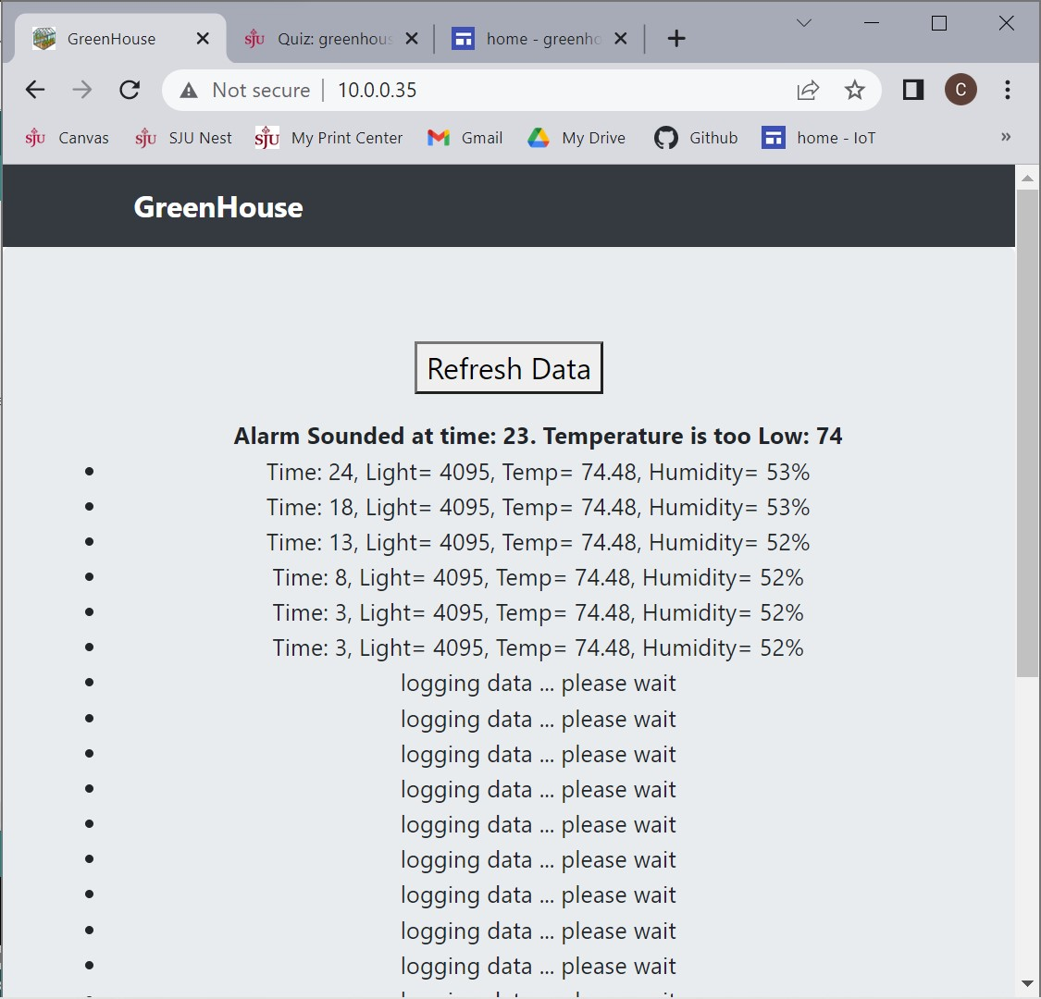
This screenshot shows how the alarm note updates its time and temperature values after refreshing.

Slide 7
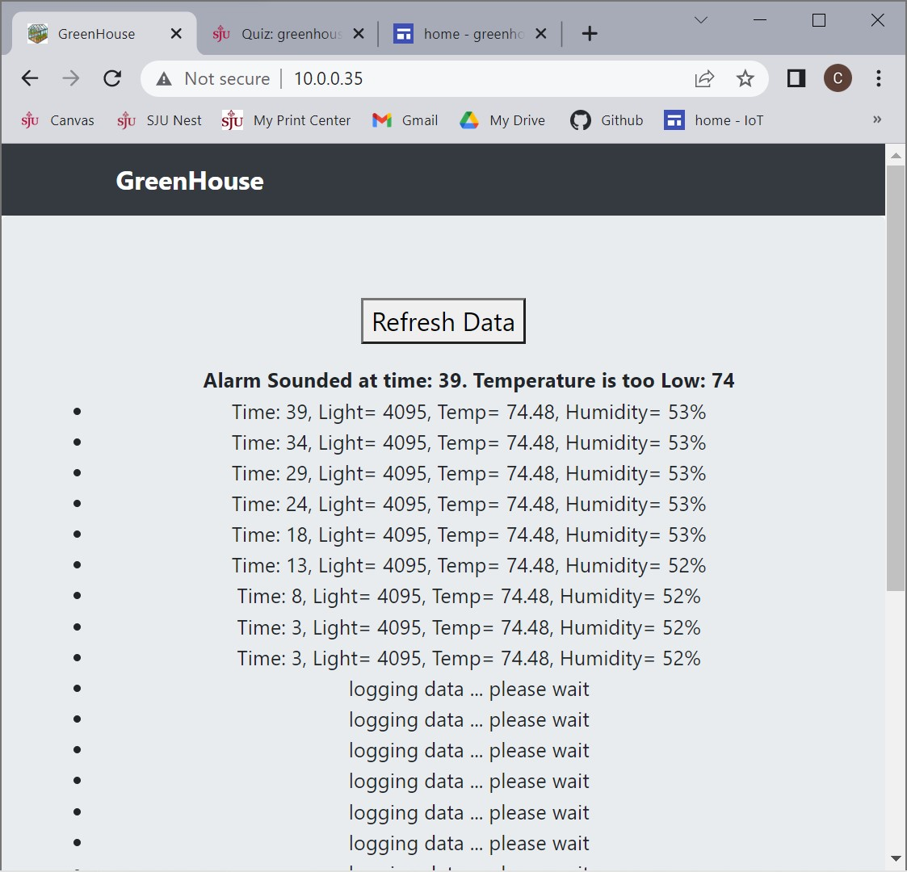
Another refresh…

Slide 8
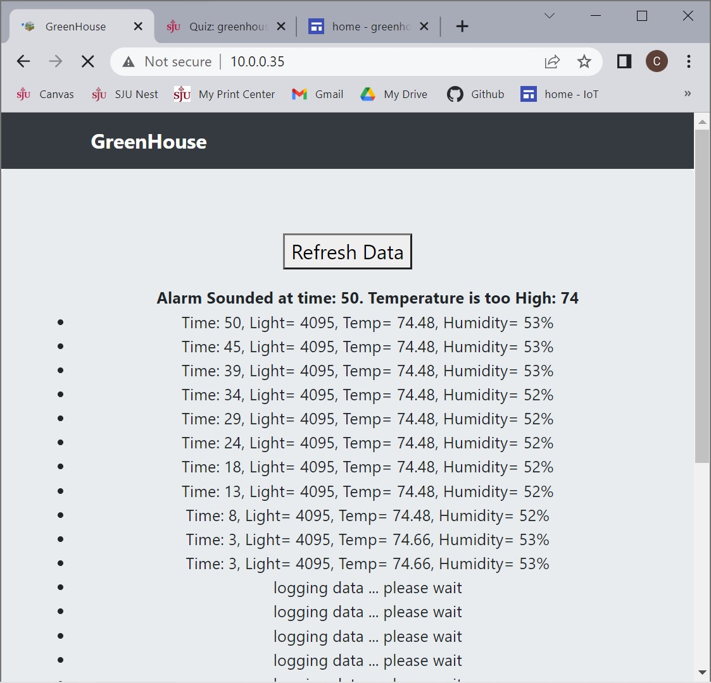
This screenshot shows the functionality of the the alarm note when temp goes too high.
Note: I changed TLOW back to a realistic value and changed THIGH to 50 so the alarm could be triggered.

